Slide 1
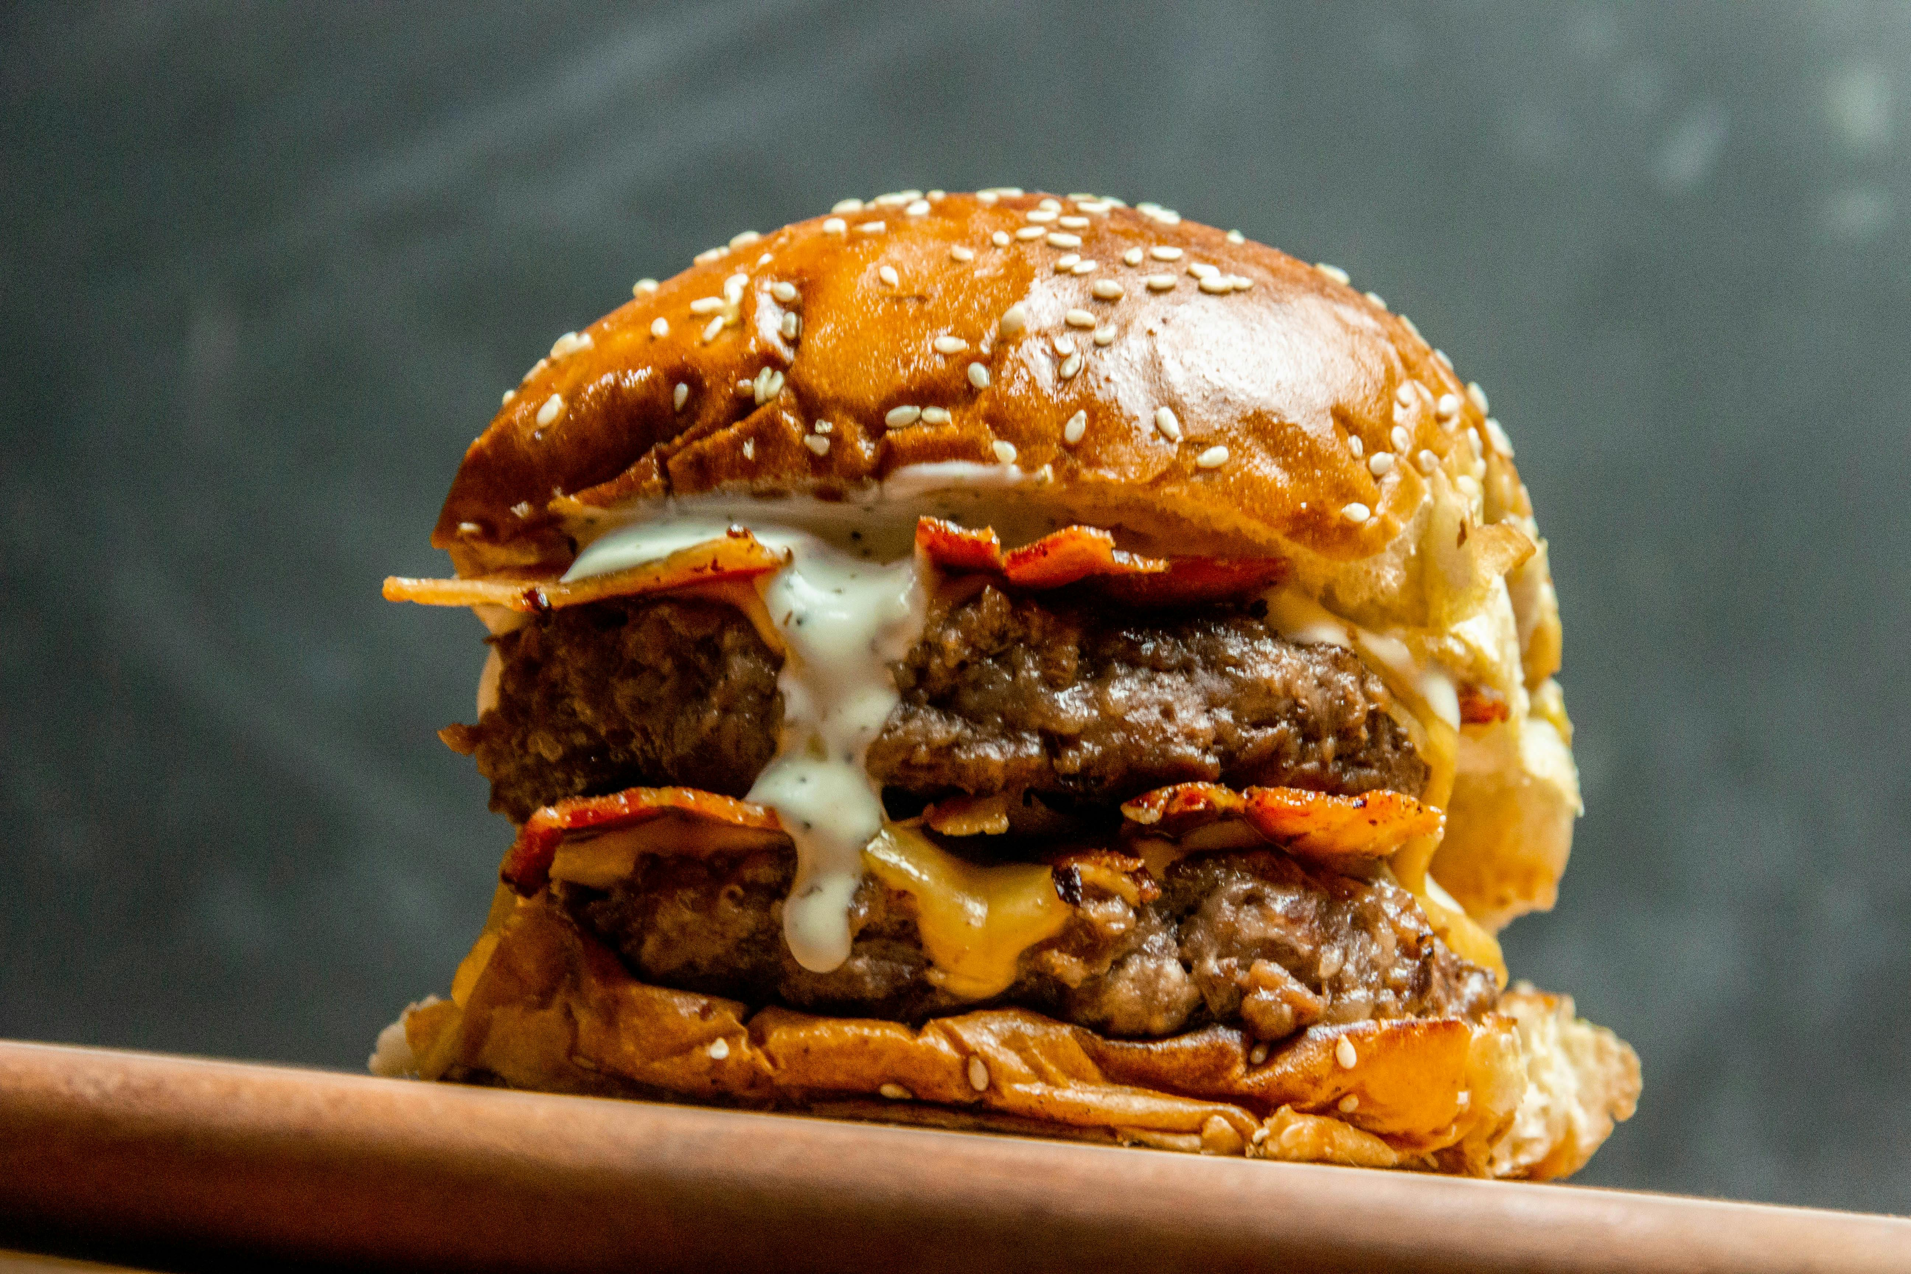
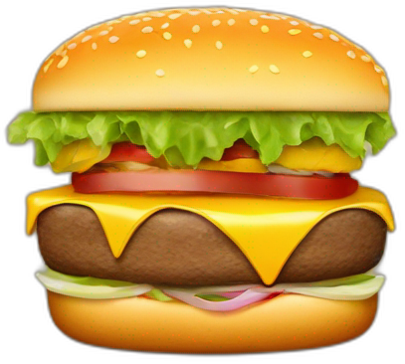
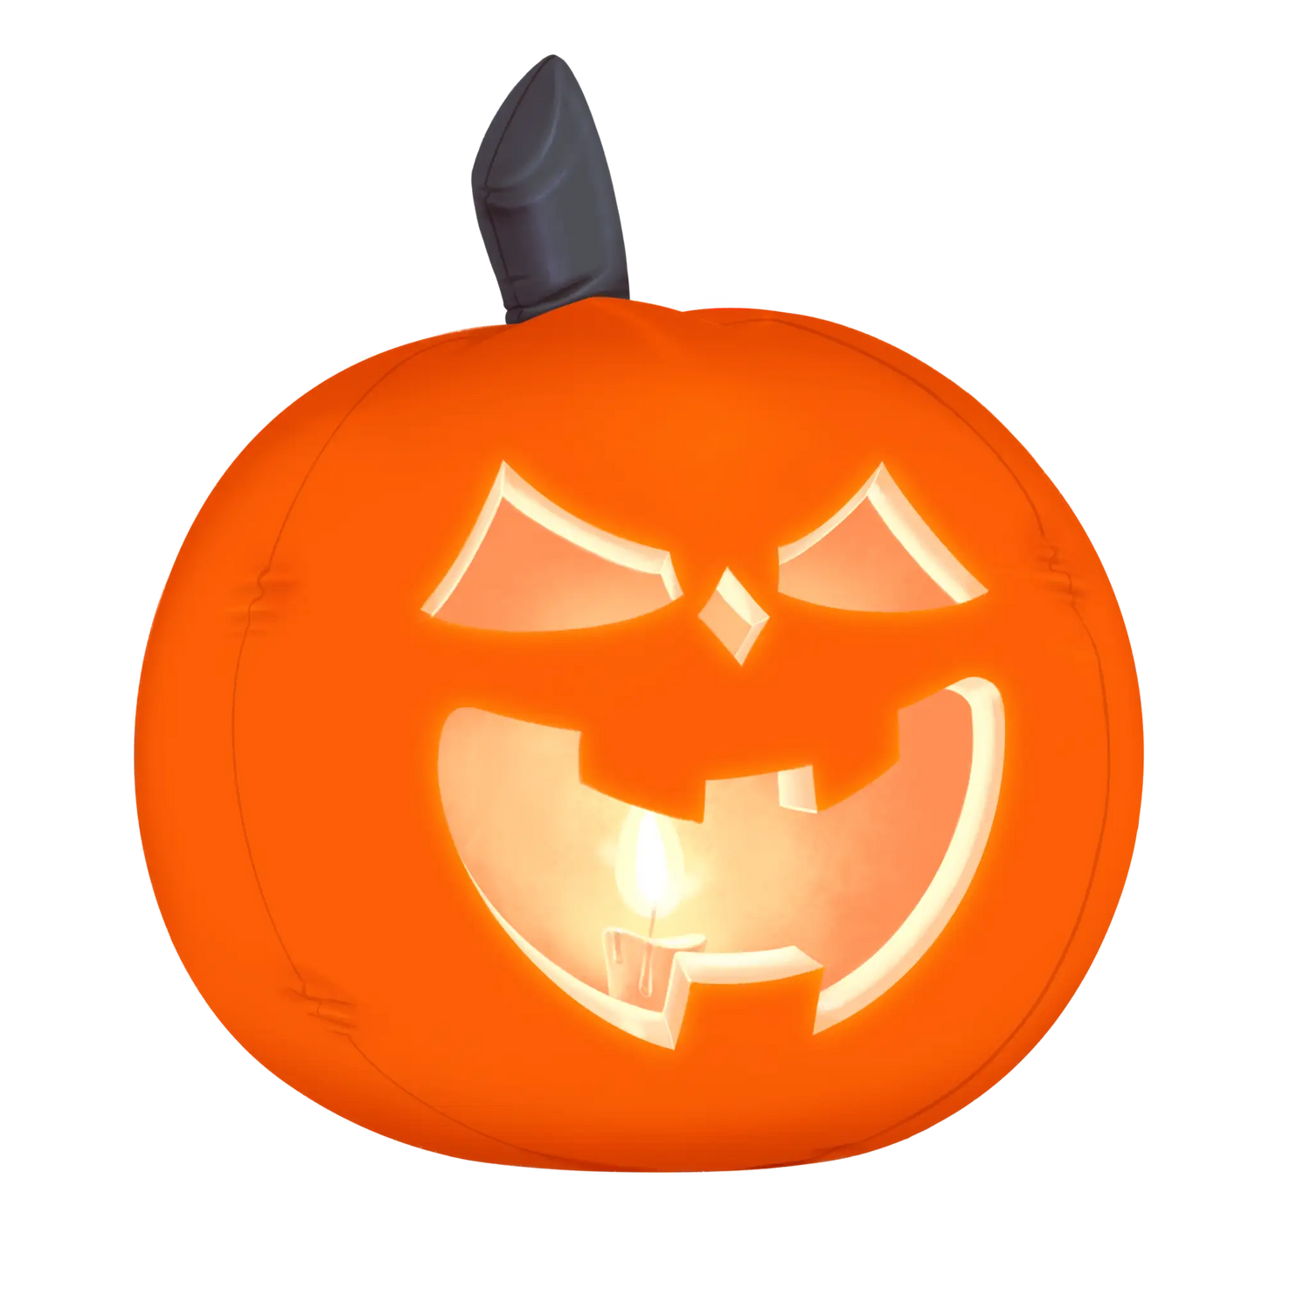
Halloween’s Special
SUPER BURGERS
SAVE
25 %
MONSTER BURGER
BACON BURGER
VALID ONLY IN MEXICO DURING OCTOBER
ORDER NOW

